Slide 1
Global Terrorism _{Exploratory Data Analysis} _{Participants} _{Ruchitha Kanakaiah Bijja} & _{Dinesh Bhuyan}

Slide 2
^{Point To Discuss}
Data Summary
Data Cleaning
Top attacked countries, cities, regions, years, months, groups
In the world Map The Top Attacked Countries
Attacks in every year
Terrorist groups name and number of killed peoples
Maximum number of deaths/kills in each country which is greater than 200
AL-QAIDA
Check which region is affected by terrorism in each year
Most active gang in recent years
Top 11 most attacked countries
Gang which caused the maximum deaths in recent years
Challenges faced
Conclusion

Slide 3
Data Summary/Data Cleaning
Shape of data:- rows-181691,columns- 135
Null values:- Those values which are not available.
Drop_column:- Drop those columns which holds null values and unnecessary data.
Dataset:- Fully cleaned data

Slide 4
Top attacked in country, city, region, year,month, group
Country with most attacks: Iraq
City with most attacks: Baghdad
Region with the most attacks: Middle East & North Africa
Year with the most attacks: 2014
Month with the most attacks: 5
Group with the most attacks: Taliban
Most Attack Types: Bombing/Explosion

Slide 5
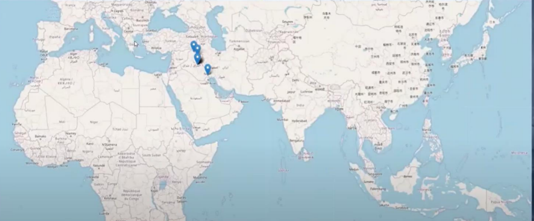
In world map top attacked country

Slide 6
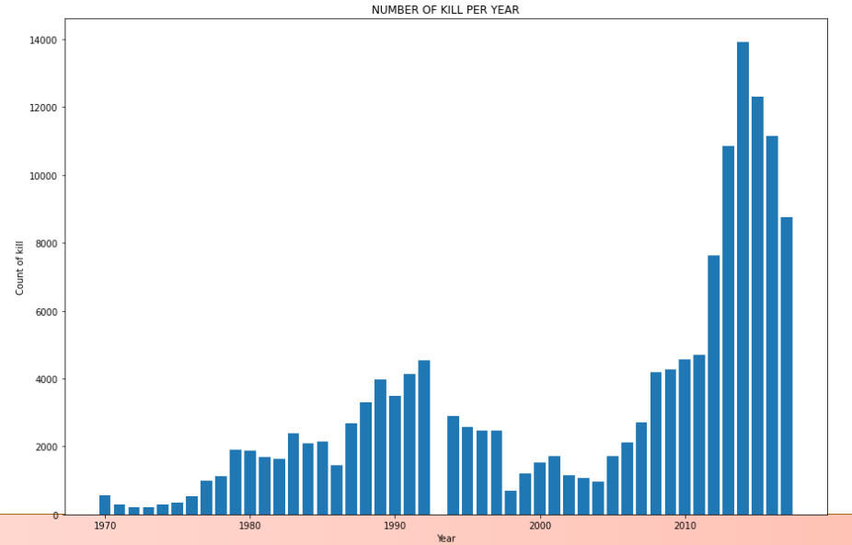
Attacks in every year
From the adjacent figure,we came to
know about the total number of terrorist
attacks in the years from 1970 to 2017.
We can conclude that most attacks were
done in the year 2014.
We can see here that attacks slowly start
to increase from 1972 until about 1993
where until 2004 we see a downward
global trend in terrorist incidents then
after 2014 the terrorist activities starts
increasing till 2014 then slowly decreases.

Slide 7
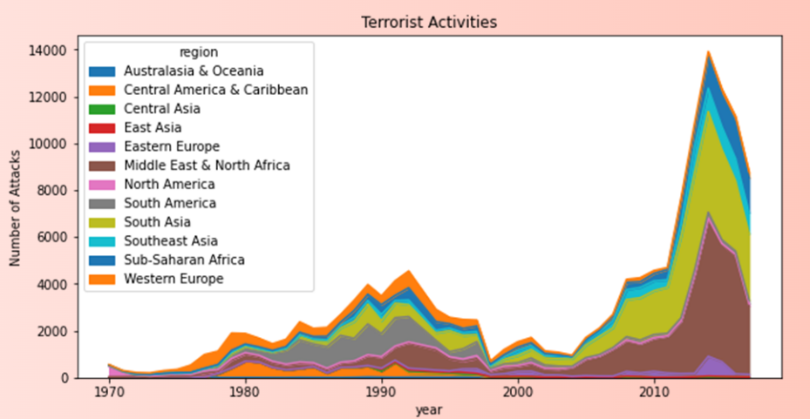
Terrorist Activities (Number of Attacks v/s Year)
The adjacent graph is plottedusing
area graph.It shows the total number
of attacks in corresponding years and
region. Most attacks were made in
2014 on Australasia & Oceania.In the
1970s we can see that most terrorist
attacks occurred in Western Europe,
followed by South America in the 1980s.
But then there is an overall decline in
the number of attacks between the
mid-1990s and 2003.

Slide 8
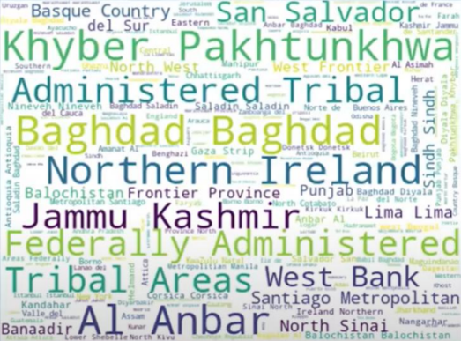
Word cloud
We can see in this word cloud
diagram that
Khyber Pakhtunkhwa
Administered Tribal
Baghdad
Northern Ireland
Jammu Kashmir are the
highly affected areas.

Slide 9
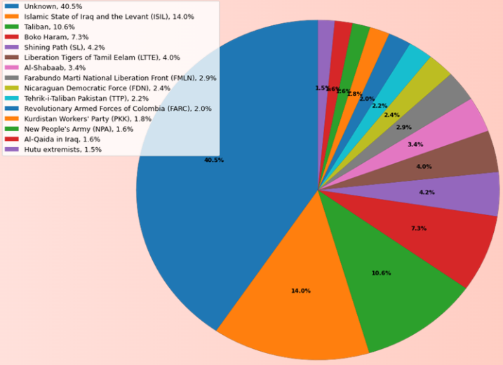
Percentage of attacks by each gangs out of total
The adjacent figure
is plotted using a pie
chart. Which shows
the percentage of
attacks made by
different terrorist
groups out of total
attacks.

Slide 10
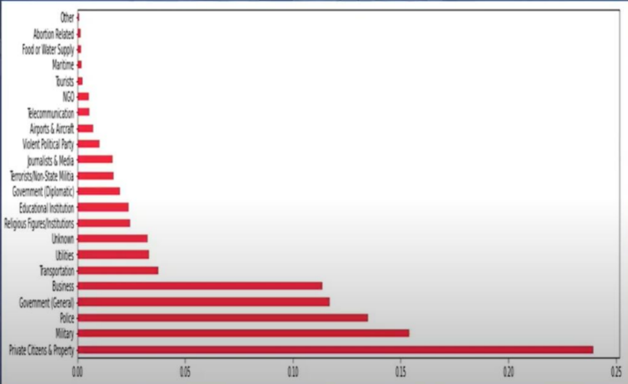
To know the target type of terrorists
The attached picture
depicts that most of
the terrorist gangs
targeted the private
citizens and
property followed
by military, police

Slide 11
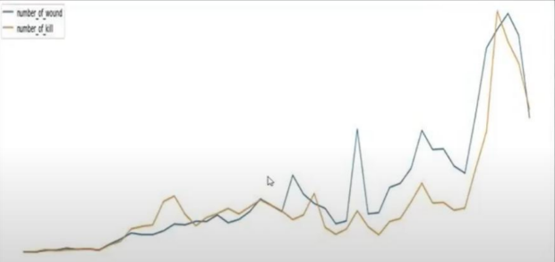
Compare the Number of kills and number of wounds
The attached graph
shows the number of
kills and number of
wounds by different
terrorist groups.

Slide 12
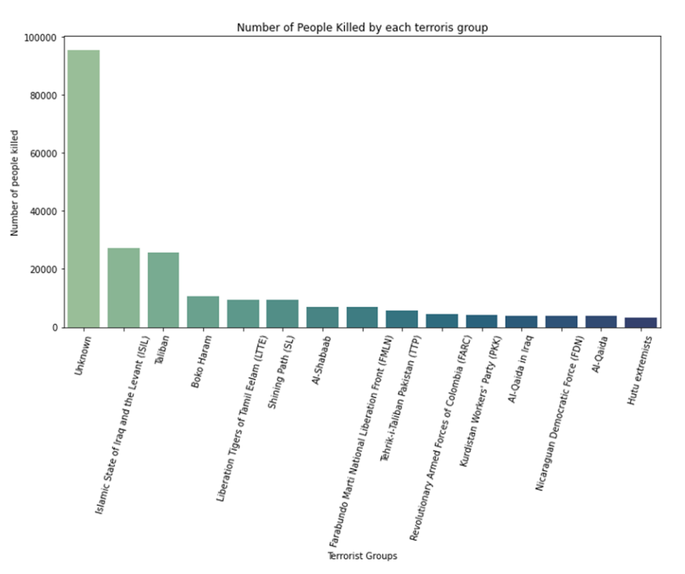
Terrorist group name and number of killed
From the bar graph, which shows
the number of people killed by
different terrorist groups, we can
say that most people were killed
by terrorists which is unknown
followed by ISIL and the least
number of people were killed by
Hutu extremists group.

Slide 13
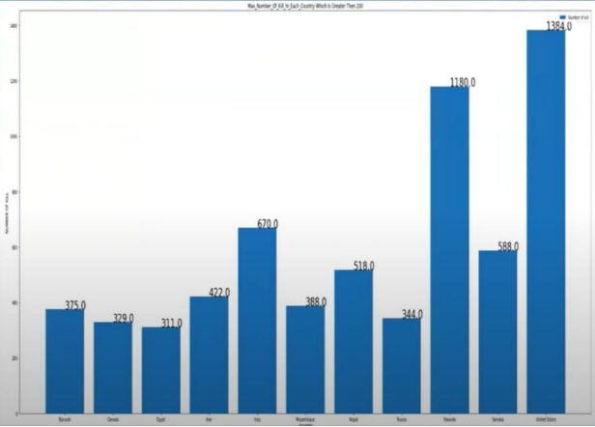
Max number of kill in each country which is greater than 200
The attached bar graph displays
the total number of people killed
in different countries. We can say
that the most people were killed
in United States i.e., 1384 people.

Slide 14
AL-QAIDA
AL_Qaida the most mischievous gang in early 20's have done most number kill till date and the weapon used for killing are
only two:
Explosives and vehicle-borne explosive
so if we control on the illegal transportation of weapons then we can reduce terrorist activities.
We can see that in only one year (2001) there were 2 attacks on the same day and on the same country......
so we can say that there might me some dispute between USA
and Al_Qaida

Slide 15
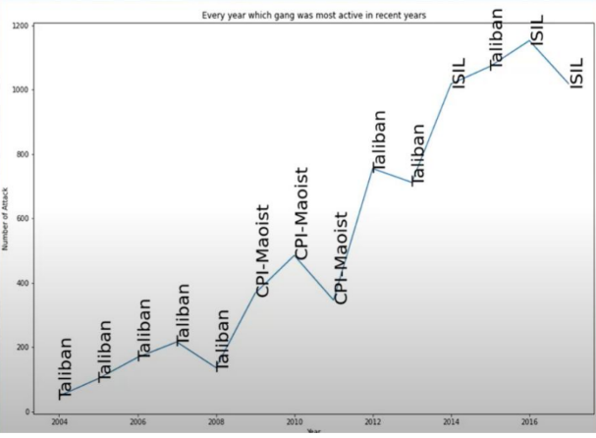
To check which region is affected by terrorism in each year
From the depicted map which
shows the total number of
attacks by different terrorist
groups in different years, we
can say the most active
terrorist gang is taliban.

Slide 16
Top 11 most attacked countries
Country | Number of kill
Iraq | 21510
Pakistan | 12756
Afghanistan | 10871
India | 10491
Colombia | 6865
Philippines | 5843
Peru | 4916
Turkey | 3767
El Salvador | 3369
Thailand | 3346
United Kingdom | 3212

Slide 17
Challenges faced
Working on this amazing topic was very informative for us. The challenges we faced here in it were bare minimum.
The challenges we faced are listed as below:
1. To extract the dataset holding the columns with excluded naan values. Doing this we didn't want to loose any non-naan values but we did loose.
2. We wanted to utilise all the columns as we consider that each column given in the dataset must have some relation with another column, and if not we can create by performing a search analysis. And we did it for a few columns but some were still proved to be unwanted....and unfortunately with an ugly heart we had to dump those unwanted columns.
3. We found very less columns holding character data as compared to numerical data....which affected the efficacy of the correlation.
4. The biggest challenge which occurred was to figure out the name of the 'Unknown column' which held the most number of deaths...a challenge in putting up the most required information.

Slide 18
Conclusion -1
1.Country with most attacks: Iraq
2.City with most attacks: Baghdad
3.Region with the most attacks: Middle East & North Africa
4.Year with the most attacks: 2014
5.Month with the most attacks: 5
6.Group with the most attacks: Taliban
7.Most Attack Types: Bombing/Explosion

Slide 19
Conclusion-2
8.gang_name VS number of kill
a) Islamic State of Iraq and the Levant (ISIL) 27174
b) Taliban 25785
c) Boko Haram 10732
d) Liberation Tigers of Tamil Eelam (LTTE) 9392
e) Shining Path (SL) 9315
f) Al-Shabaab 6836
g) Farabundo Marti National Liberation Front (FMLN) 6801
h) Tehrik-i-Taliban Pakistan (TTP) 6580
i) Revolutionary Armed Forces of Colombia (FARC) 4380
j) Kurdistan Workers' Party (PKK) 4093
k) Al-Qaida in Iraq 3984
l) Nicaraguan Democratic Force (FDN) 3883
m) Al-Qaida 3818
n) Hutu extremists 3203

Slide 20
Conclusion-3
12.YEAR--GANG------NUMBER OF MAXIMUM KILL
a) 2004 --- Taliban---48
b) 2005 --- Taliban---102
c) 2006 --- Taliban---168
d) 2007 --- Taliban---216
e) 2008 --- Taliban---136
f) 2009 --- CPI-Maoist---367
g) 2010 --- CPI-Maoist---485
h) 2011--- CPI-Maoist---346
i) 2012 --- Taliban---755
j) 2013 --- Taliban---712
k) 2014 --- ISIL---1018
I) 2015 --- Taliban---1073
m) 2016 --- ISIL---1153
n) 2017--- ISIL---1019

Slide 21
Conclusion-4
9.Maximum human killed by Al-Qaida
10.In last 20 year Al-Qaida is not active Gang.
11.country VS number_of_kill
a)Iraq 21510
b) Pakistan 12756
c) Afghanistan 10871
d) India 10491
e) Colombia 6865
f) Philippines 5843
g) Peru 4916
h) Turkey 3767
i) El Salvador 3369
j) Thailand 3346
k) United Kingdom 3212

Slide 22
Conclusion-5
13.From Last 20 Year 3 Gang are active.
a) Taliban
b) CPI
c) ISIL

Slide 23
Conclusion-6
14. These are two methods mostly used by all three most active gangs is Bombing/Explosion, Armed Assault and Hostage Taking (Kidnapping).
15.Al-Qaida the most mischievous gang in early 20's has done the most number of kills till date and the weapons used for killing is only two explosives and vehicle-borne explosive so if we control on the illegal transportation of weapons, we can reduce the attacks in only one year (2001). There were 2 attacks on the same day so we can say that there might be some disputes between USA and Al Qaida

Slide 24
Thank you

